Slide 1


SIGNIFICANT ROOM FOR REVENUE BOOST DURING BIG EVENTS & CUSTOMER SEGMENTATION
Personal Gift Platform
GREEN ANALYST
Phạm Minh Toàn
Lê Thụy Bảo Ngân
Phạm Hoàng Phúc

Slide 2
EXECUTIVE SUMMARY
1
1. SITUATION
Overview report on Beloved and Beyond's operations between 2022 and 2023. Focusing analysis on 3 main events including: Valentine's Day, International Women's Day, and Vietnamese Women’s Day. The analysis evaluates conversion rates and customer return rates using Sales Funnel and RFM Model to prioritize customer groups.
2. ANALYSIS
The report showed that the conversion rate from account subscribers to buyers was 15.5%, with only 2.8% of subscribers converting into returning customers.
3. PORTRAIT
Beloved & Beyond customer divided into categories by using the level of recency and the level of engagement, which potential customers are Champions & Loyal segments.
4. RECOMMENDATION
Membership Program & better Quality of Service
Upsell Strategy & Profit Margin Distribution to Charity
SITUATION
ANALYSIS
PORTRAIT
RECOMMENDATION

Slide 3
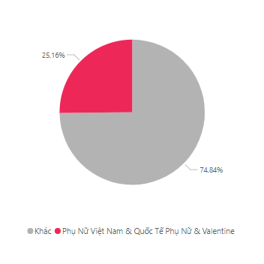
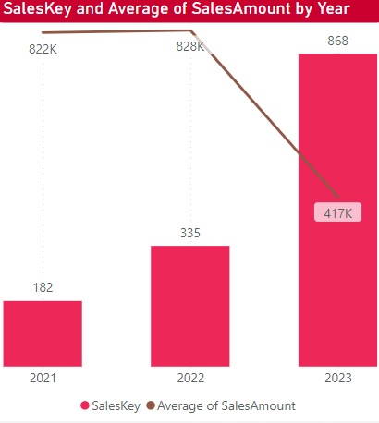
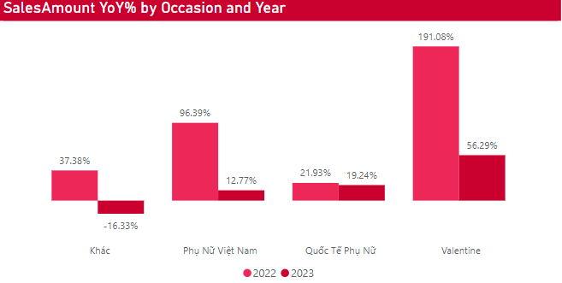
REVENUE INCREASED MODERATELY YOY BY MAJOR EVENTS AND WHY
2
Frequency by Occasion
Sales Amount YoY% by Occasion and Year
Sales Key and Average of Sales Amount by Year
Vietnamese Women's Day, International Women's Day and Valentine's Day still had revenue growth from 2022 to 2023.
Revenue in 2023 grew slowly although the number of orders had increased significantly due to the difficult economic situation in 2023, so the average value of buyers' orders decreased compared to 2022.
Sales Key in 2022 & 2023 increased by 1.84 times and 4.77 times, respectively, compared to 2021. However, there was a notable change in the average revenue value, with the level remaining firmly above 800,000 VND drops to 417,000 VND per order by 2023. This shows clear signs that customers are prioritizing products with lower prices.
SITUATION
ANALYSIS
PORTRAIT
RECOMMENDATION

Slide 4
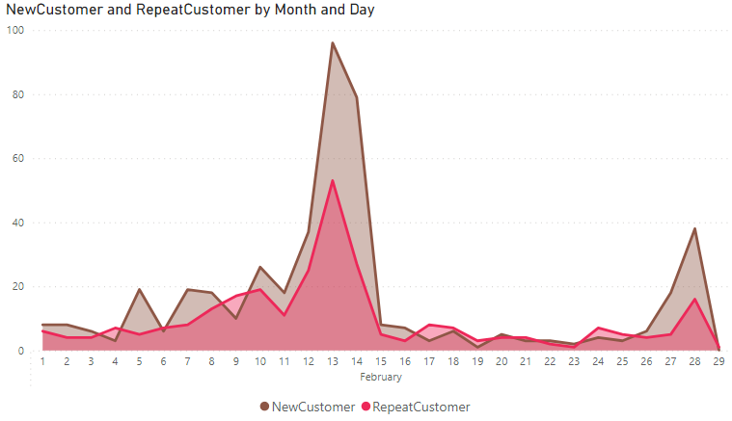
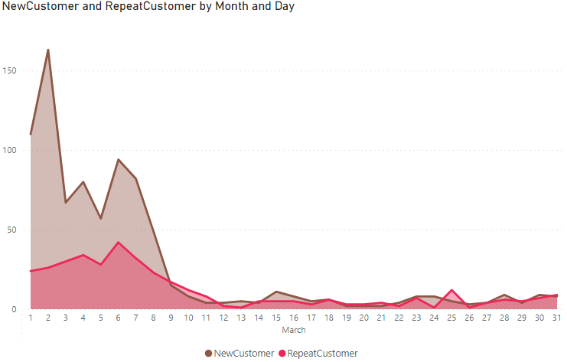
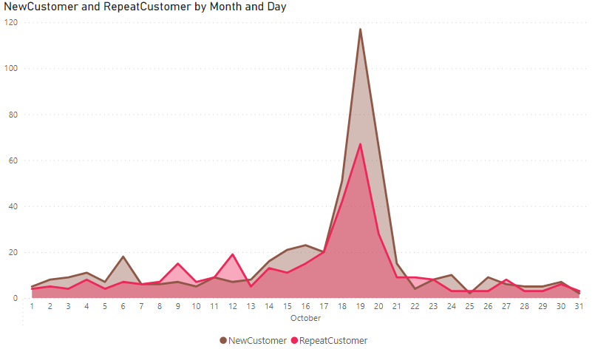
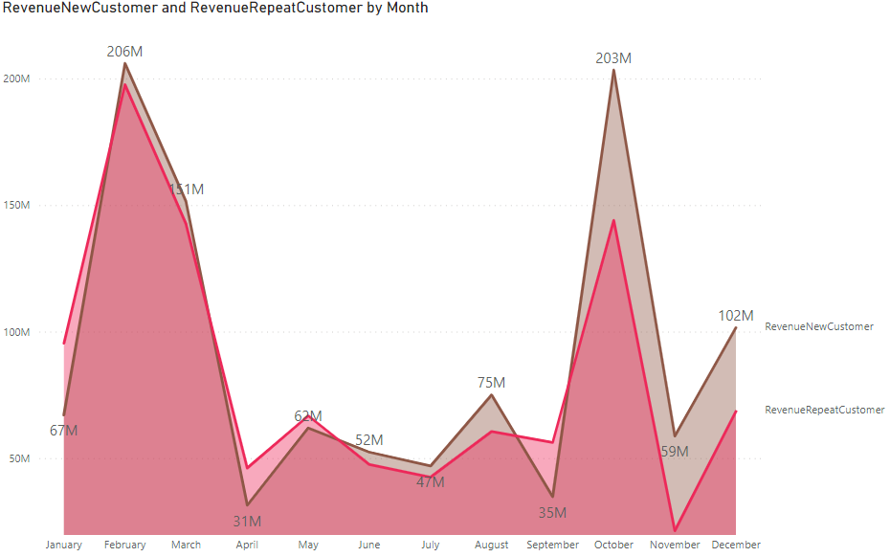
SALES CONTRIBUTION BY MAJOR EVENTS BETWEEN 2022 AND 2023
3
New Customer and Repeat Customer by February
New Customer and Repeat Customer by March
New Customer and Repeat Customer by October
96
163
117
53
94
67
42
Revenue New Customer & Revenue Repeat Customer by Month
Repeat customers also regularly returned on 3 major holidays. The ratio of new customers to returning customers during Valentine's Day, International Women's Day and Vietnamese Women's Day was 1.81, 2.23 and 1.74 times respectively, concentrated in Ho Chi Minh City (Appendix 3).
SITUATION
ANALYSIS
PORTRAIT
RECOMMENDATION

Slide 5
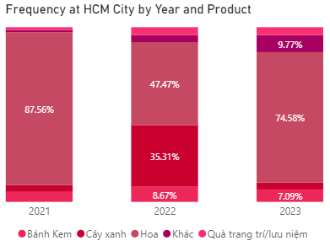
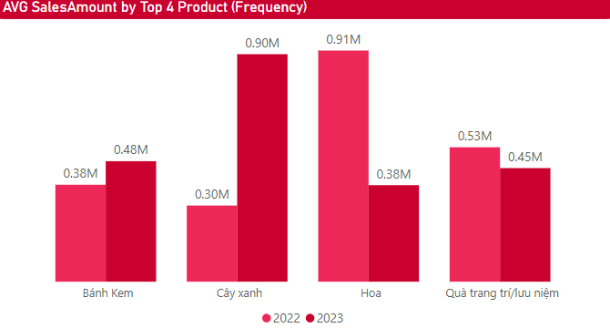
FLOWERS WERE STILL THE MAIN PRODUCT OF BELOVED & BEYOND
4
Frequency by Year and Product
AVG Revenue by Top 4 Product in 3 big occasions
633.4K
AVG Revenue of Hoa
579.4K
AVG Revenue of CayXanh
442.6K
AVG Revenue of BanhKem
During the main holidays, there was a diversification of gifts, bringing many choices, but flowers still dominate with 87.56% of orders in 2021. There was a decrease in the proportion of Flower orders in 2022 to 47.47% due to the increase of Green Plants but it quickly recovered to 74.58% in 2023.
In 2022, the average revenue per holiday order of green plants was 300,000 VND, but by 2023, the average revenue per 1 order of green trees reached 900,000 VND.
SITUATION
ANALYSIS
PORTRAIT
RECOMMENDATION

Slide 6
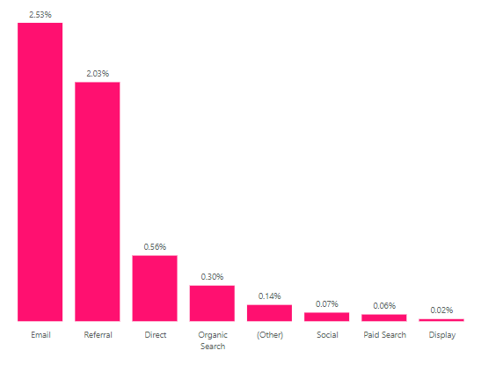
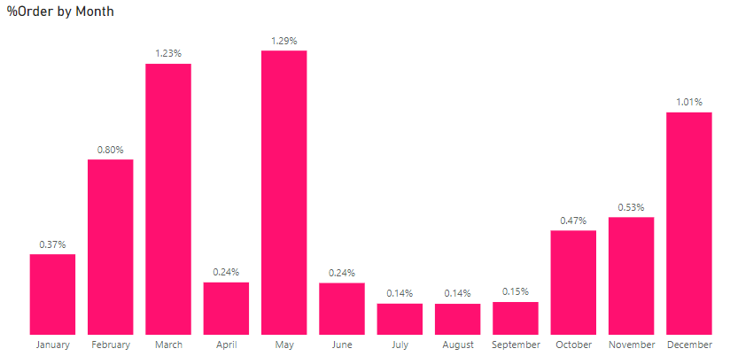
CONVERSION RATE WAS HIGHEST ON EMAIL AND REFERRAL
5
172.91K
AVG of New Users
144.50
AVG Session Duration
219.74K
AVG of Sessions
3.14
AVG of Pages/ Session
67.36%
Bounce Rate
0.67%
Goal Conversion Rate
Conversion rate by channel from Google Analytics
Conversion rate by month from Google Analytics
Conversion rate from email and referrals from return customers was the highest, 2.53% and 2.03% respectively.
Although major events accounted for the highest total number of orders and revenue, the conversion rate from channels was not really effective, especially in October (0.47%). Meanwhile, the highest conversion rate by order falls in May with 1.29%, followed by March with 1.23%.
SITUATION
ANALYSIS
PORTRAIT
RECOMMENDATION

Slide 7
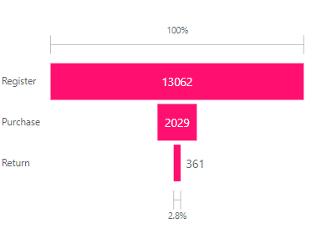
CONVERSION RATE FROM USERS TO CUSTOMERS WAS LOW
6
Sales Funnel by User
The conversion rate from account registrants to customers was 15.5%, the conversion rate from customers to returning customers was 17.8% → Only 2.8% of registrants converted into returning repeated customers.
Reason:
Customers may decide not to make a purchase after registering an account because the experience of browsing products and the shopping process on the website does not reach the expected convenience.
The content, description and design of the products sold are not impressive in terms of price and image description, and do not promote Call to Action. This can create hesitation for users and cause them to hesitate before deciding to order the product.
Consumers' procrastination habits and behaviors have not been resolved quickly, causing products to only be kept and forgotten for a while.
SITUATION
ANALYSIS
PORTRAIT
RECOMMENDATION

Slide 8
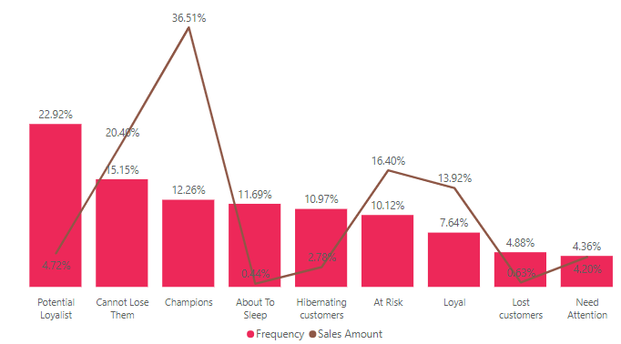
TARGET THE CHAMPIONS & LOYAL CUSTOMER SEGMENT
7
Frequency and Sales Amount by Segment
Prioritize strategies to reach customer segments that account for a low percentage of orders but bring high revenue: Champions and Loyal (Appendix 1).
SITUATION
ANALYSIS
PORTRAIT
RECOMMENDATION

Slide 9

8
SEGMENT 1: HIGH AOV, WITHOUT DISCOUNTS BUT BETTER CUSTOMER SERVICE
AOV | 1,001,014 VND
Top 3 Relationship | Lover, Family, Others
Top 3 Occasion | Birthday, Vietnamese Women Day, Others
Top 3 Product | Flower, Cake, Plants
“Preparing to Leave” group is a potential customer segmentation when its CLV exceeded the average CLV of B&B
>
CUSTOMER LIFETIME VALUE
$1245
$1050
Preparing to Leave
“Preparing to Leave” group
Standard
“Love” is the important gift-giving relationship that “Preparing to Leave” group values.
Delivery service is not good enough for this segment.
AVERAGE DELIVERY DAYS
3.06 | 2.12
Contribution to revenue
Frequency
(orders/ month)
Recency
(months)
Engagement
(months)
Focus on the value of products and services, price was not a concern.
20%
7.45
39.5
27
SITUATION
ANALYSIS
PORTRAIT
RECOMMENDATION

Slide 10
SEGMENT 2: MAIN SEGMENT - MORE THAN HAFT OF TOTAL ORDERS
9
AOV | 802,079 VND
Top 3 Relationship | Lover, Others, Family
Top 3 Occasion | Vietnamese Women Day, Birthday, Others
Top 3 Product | Flower, Decorations, Plants
The AOV of this group met the expectation.
AOV = $35
VIP
51,5%
Order of
B&B
VIP segment held the highest total orders.
<
<
7.45
FREQUENCY
(orders/ month)
0.64
3.29
VIP group
NEW group
Preparing to Leave group
Frequency in the VIP segment only reached 3rd compared others.
High engagement but frequency is not good, is there a problem related to Call to Action?
Contribution to revenue
Frequency
(orders/ month)
Recency
(months)
Engagement
(months)
62%
0.64
36
2.86
SITUATION
ANALYSIS
PORTRAIT
RECOMMENDATION

Slide 11

ACTION 1: MEMBERSHIP PROGRAM & BETTER QUALITY OF QUALITY
10
MEMBERSHIP PROGRAM
QUALITY OF SERVICE
.
.
Be motivated to make another other
Offer long term relationship with brand
Sense satisfaction after using service
Shorten length of shipping days
Complete orders to earn points on membership card
Optimize landing page, enhance website display
Desire to minimize their total payment
Impressed with the content, product description, design
 | AOV | GMV
GOLD | 1,600,000 | 4,000,000
SILVER | 1,200,000 | 3,400,000
BRONZE | 900,000 | 2,500,000
Notify products in the shopping cart for a certain period of time
Convenience in the way collecting points
Willing to put good reviews for B&B
Add review section for customer after sales.
SITUATION
ANALYSIS
PORTRAIT
RECOMMENDATION

Slide 12
ACTION 2: UPSELL STRATEGY & PROFIT MARGIN DISTRIBUTION TO CHARITY
11
CHARITY CAMPAIGN
UPSELL STRATEGY
.
.
Contribute to increasing brand awareness
Be motivated to make another other
Prioritize the value the product brings
Highlight value and USP of the product
Allocate 10-20% of profit margin more than 0.6 to charity
Indirectly perform actions that are beneficial to society
Impressed with the content, product description, design
Personalize users based on preferences and behavior
Profit Margin | <0.6 | >0.6
Flower | 4608 | 627
Plants | 616 | 2
Cake | 306 | 2
Decorations | 177 | 1
Others | 255 | 4
Create a strong connection with B&B
Offer many similar options to choose from
Enhance the quality and design of products
Note: See appendix 2 to know why flash sale is not applied
SITUATION
ANALYSIS
PORTRAIT
RECOMMENDATION

Slide 13
APPENDIX 1: RFM MODEL
12
Data is compiled from 3874 customers, with purchase data from January 1, 2019 to October 23, 2023.
Based on data distribution, each customer's RFM score is divided as follows:
RECENCY:
Level 1: Last order > 1265 days ago
Level 2: Last order was from 733 to 1265 days ago
Level 3: Last order was from 500 to 733 days ago
Level 4: Last order was 264 to 500 days ago
Level 5: Last order < 264 days ago
FREQUENCY:
Level 1: Order once from January 1, 2019 to October 23, 2023.
Level 2: Order once from January 1, 2019 to October 23, 2023.
Level 3: Order once from January 1, 2019 to October 23, 2023.
Level 4: Order twice from January 1, 2019 to October 23, 2023.
Level 5: Order > 2 times from January 1, 2019 to October 23, 2023.
MONETARY:
Level 1: Total amount spent per order < 50,000 VND
Level 2: Total amount spent per order from 50,000 to 365,000 VND
Level 3: Total amount spent per order from 365,000 to 707,000 VND
Level 4: Total amount spent per order from 707,000 to 1385,000 VND
Level 5: Total amount spent per order > 1,385,000 VND
Each customer will be scored on three factors: Recency, Frequency, and Monetary (R, F, and M). Each factor is scored relative to the entire customer base, scored on a scale of 1 to 5, where 1 is the lowest score and 5 is the highest score compared to the entire customer file. Then, these 3 scores will be combined into a single RFM index used to classify customers into each group.
SITUATION
ANALYSIS
PORTRAIT
RECOMMENDATION

Slide 14
APPENDIX 1: RFM MODEL
13
Customer Segment | Activity | Scores
Champions | Bought recently, buy often and spend the most | 555, 554, 544, 545, 454, 455, 445
Loyal | Spend good money with us often. Responsive to promotions | 543, 444, 435, 355, 354, 345, 344, 335
Potential Loyalist | Recent customers, but spent a good amount and bought more than once. | 553, 551, 552, 541, 542, 533, 532, 531, 452, 451, 442, 441, 431, 453, 433, 432, 423, 353, 352, 351, 342, 341, 333, 323
New Customers | Bought most recently, but not often | 512, 511, 422, 421, 412, 411, 311
Promising | Recent shoppers, but haven’t spent much | 525, 524, 523, 522, 521, 515, 514, 513, 425, 424, 413, 414, 415, 315, 314, 313
SITUATION
ANALYSIS
PORTRAIT
RECOMMENDATION

Slide 15
APPENDIX 1: RFM MODEL
14
Customer Segment | Activity | Scores
Need Attention | Above average recency, frequency and monetary values. May not have bought very recently though. | 535, 534, 443, 434, 343, 334, 325, 324
About To Sleep | Below average recency, frequency and monetary values. Will lose them if not reactivated. | 331, 321, 312, 221, 213, 231, 241, 251
At Risk | Spent big money and purchased often. But long time ago. Need to bring them back. | 255, 254, 245, 244, 253, 252, 243, 242, 235, 234, 225, 224, 153, 152, 145, 143, 142, 135, 134, 133, 125, 124
Can't Lose Them | Made biggest purchases, and often. But haven’t returned for a long time. | 155, 154, 144, 214, 215, 115, 114, 113
Hibernating Customers | Last purchase was long back, low spenders and low number of orders. | 332, 322, 231, 241, 251, 233, 232, 223, 222, 132, 123, 122, 212, 211
Lost customers | Lowest recency, frequency, and monetary scores. | 111, 112, 121, 131, 141, 151
SITUATION
ANALYSIS
PORTRAIT
RECOMMENDATION

Slide 16
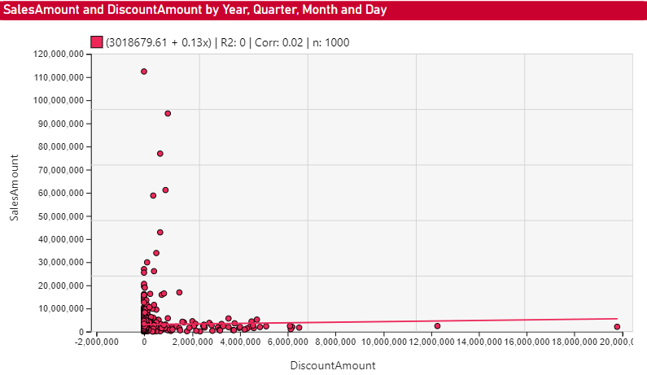
APPENDIX 2: CORRELATION BETWEEN DISCOUNT & REVENUE
15
Conclusion: R^2 = 0 < 0.5, Correlation = 0.02, Discount & Revenue have a weak correlation
SITUATION
ANALYSIS
PORTRAIT
RECOMMENDATION

Slide 17
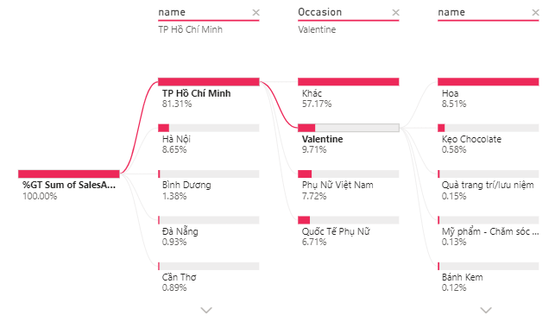
APPENDIX 3: HCM CITY ACCOUNTED FOR THE MAJORITY OF REVENUE
16
Sales Amount by Province/Occasion/Product
SITUATION
ANALYSIS
PORTRAIT
RECOMMENDATION

